Slide 1

Event-Driven Malicious URL Extractor
2021-085
18.10.2021

Slide 2




Team Members
S. W Sajeth Jonathan
IT18071412
Team Leader
Wishvajith B.L.D.V​
IT18032666
Team Member
Ramanayaka A. M​
IT18021912
Team Member
Renu Harshatha A.
IT18034400
Team Member
18.10.2021

Slide 3
Introduction
18.10.2021

Slide 4
4.66 Billion
Internet Users
Jan 2021
https://datareportal.com/global-digital-overview
18.10.2021

Slide 5
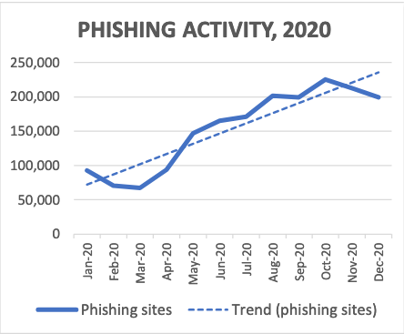
22% of data breaches involved Phishing*
APWG 2020 Q4 Report
*Verizon 2020 DBIR Report
18.10.2021

Slide 6
Research Problem
Event-driven System
Scalability
Finding URLs related to any global/local event for organizations to use as a blocklist
Adaptability of the system to change according to trending events.
18.10.2021

Slide 7
Research Problem
Classification Model
Feature Reduction
Machine Learning Models are used abundantly but sacrifices scalability and time as a trade-off
Identifying the correct features needed to build an efficient system
18.10.2021

Slide 8
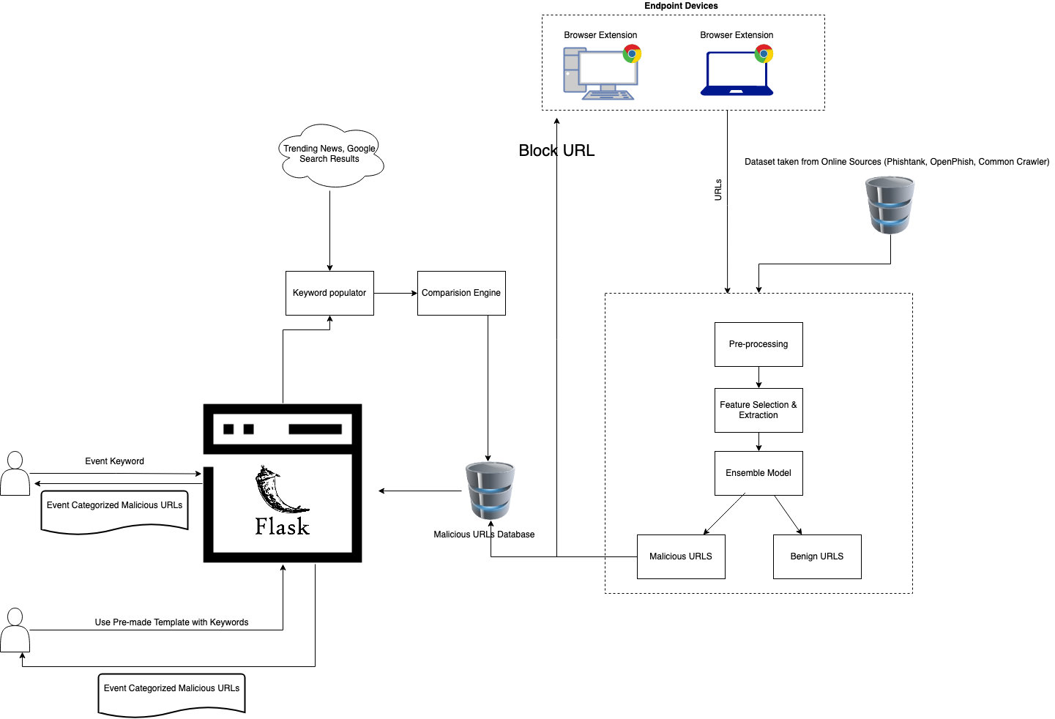
Overall System Diagram
18.10.2021

Slide 9
What have done so far?
18.10.2021

Slide 10
S. W Sajeth Jonathan IT18071412
IT18071412 | S.W Sajeth Jonathan | 2021-085 18.10.2021

Slide 11
Research Question
Which ensemble model will give adequate accuracy without trading too much in perfomance?
How to make the user interface intuitive to collect Event-based Malicious URLs ?
IT18071412 | S.W Sajeth Jonathan | 2021-085 18.10.2021

Slide 12
Objectives
Main Objective
Experiment and test combinations of various ML/DL models to find an effective ensemble model
Bidirectional LSTM + CNN [7]
IT18071412 | S.W Sajeth Jonathan | 2021-085 18.10.2021

Slide 13
Objectives
Sub Objectives
Collect Training and Testing data from publicly available sources
OpenPhish
PhishTank
Common Crawler
Alexa
IT18071412 | S.W Sajeth Jonathan | 2021-085 18.10.2021

Slide 14
Objectives
Sub Objectives
Build the webite using Python Flask Framework to collect event-based phishing URLs to detect malicious links early in the attack lifecycle
Provide Visualization to Viewers
Export Event-based databases in CSV Format
IT18071412 | S.W Sajeth Jonathan | 2021-085 18.10.2021

Slide 15

Completion upto PP-1
Compared LSTM models with Bi-direcional Models
Did initial testing with RFCs and DTs
Built the UI using Chart.js
55%
IT18071412 | S.W Sajeth Jonathan | 2021-085 18.10.2021

Slide 16
Completion upto PP-2
Run the classification model up to 50/100 epoch and compare output
Reduce model training time
Add a CNN model to complete the ensemble modeling process
90%
IT18071412 | S.W Sajeth Jonathan | 2021-085 18.10.2021

Slide 17
1. Run the classification model up to 50/100 epoch and compare output
83.1%
93.2%
97.99%
5 Epoch
50 Epoch
100 Epoch
IT18071412 | S.W Sajeth Jonathan | 2021-085 18.10.2021

Slide 18
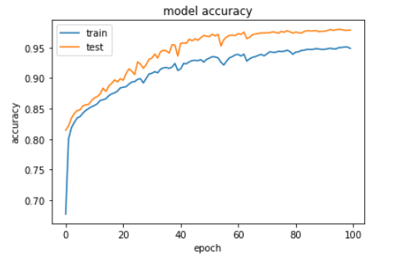
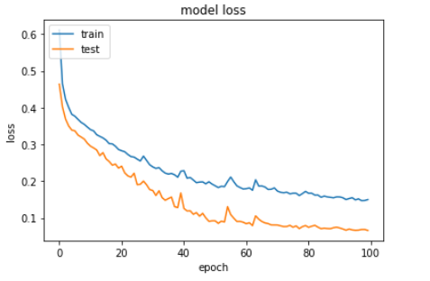
1. Run the classification model up to 50/100 epoch and compare output
83.1%
93.2%
97.99%
100 Epoch
IT18071412 | S.W Sajeth Jonathan | 2021-085 18.10.2021

Slide 19
2. Reduce model training time
Earlier models allowed up to 2048 characters from URLs in the dataset.
Model took around 20 hours to train.
~ 740s per epoch x 100 epoch
83.1%
93.2%
97.99%
IT18071412 | S.W Sajeth Jonathan | 2021-085 18.10.2021

Slide 20
2. Reduce model training time
Reduced characters to 75 characters and added padding for URLs less than 75 characters
Model took around 25 minutes to train.
~ 15s per epoch x 100 epoch
83.1%
93.2%
97.99%
IT18071412 | S.W Sajeth Jonathan | 2021-085 18.10.2021

Slide 21
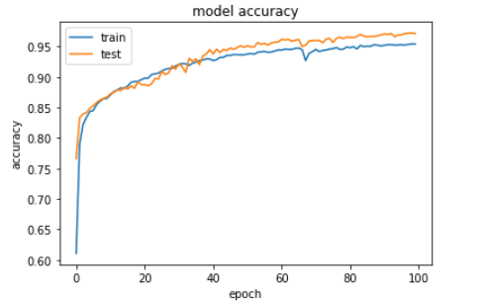
2. Reduce model training time
The reduced accuracy is negligible compared to the increased training time.
Before efficient pre-processing After efficient pre-processing
83.1%
93.2%
97.99%
97.99%
97.57%
IT18071412 | S.W Sajeth Jonathan | 2021-085 18.10.2021

Slide 22

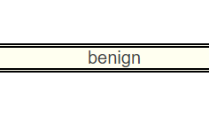
3. Deployement
IT18071412 | S.W Sajeth Jonathan | 2021-085 18.10.2021

Slide 23
Future Implmentations
Add Visualization features to the website
Add a CNN model to complete the ensemble modeling process
10%
IT18071412 | S.W Sajeth Jonathan | 2021-085 18.10.2021

Slide 24
References
​[1] S. N. P. N.Badadhe, "An Efficient Approach To Detecting Phishing A Web Using K-Means And Naïve-Bayes Algorithms With Results.," International Journal of Advanced Research in Computer Engineering & Technology (IJARCET, vol. 3, no. 5, p. 1, 2014.
​[2] R. K. S. B. a. S. S. F. Sadique, "An Automated Framework for Real-time Phishing URL Detection," in 10th Annual Computing and Communication Workshop and Conference (CCWC), Las Vegas, NV, USA, 2020.
[3] ​"APWG Trend Report," 2020. [Online]. Available: https://docs.apwg.org/reports/apwg_trends_report_q4_2020.pdf. [Accessed 25 February 2020].
​[4] W. F. S. S.-G. M. S. E. Benavides, "Classification of Phishing Attack Solutions by Employing Deep Learning Techniques: A Systematic Literature Review," Research Gate, 2020.
​[5]Y. F. Z. Y. Y. W. W. T. Z. P. Yi, "Web Phishing Detection Using a Deep Learning Framework," Wireless Communications and Mobile Computing, vol. 2018, 2018.

Slide 25
Wishvajith B.L.D.V. IT18032666
18.10.2021

Slide 26
Background
Almost all the previous researches/ ML systems [1], [2], [3] have been developed on the concept of identifying and categorizing malicious pages by identifying features shared by such URLs keywords.
or based on set of prior user feedbacks in order to warn the new users of those systems.
Problem is, datasets used to train these models, datasets are taken from known blacklisting sources like PhishTank.
PhishTank and these sources contain URLs which were extracted very late in their attack cycle.
IT18032666 | Wishvajith B.L.D.V. | 2021-085 18.10.2021
Notes:
Vijay Kotu, Bala Deshpande PhD, in Predictive Analytics and Data Mining, 2015 .3.4 Ensemble Modeling
Ensemble modeling is a process where multiple diverse models are created to predict an outcome, either by using many different modeling algorithms or using different training data sets.

Slide 27
Background
And, almost none of those solutions offer the capability for users to filter only the malicious URLs based on a particular event.
IT18032666 | Wishvajith B.L.D.V. | 2021-085 18.10.2021
Notes:
Vijay Kotu, Bala Deshpande PhD, in Predictive Analytics and Data Mining, 2015 .3.4 Ensemble Modeling
Ensemble modeling is a process where multiple diverse models are created to predict an outcome, either by using many different modeling algorithms or using different training data sets.

Slide 28
Research Questions
How to populate related keywords from the event given by the user?
How to match the populated keywords with the malicious URLs database?
IT18032666 | Wishvajith B.L.D.V. | 2021-085 18.10.2021
Notes:
Vijay Kotu, Bala Deshpande PhD, in Predictive Analytics and Data Mining, 2015 .3.4 Ensemble Modeling
Ensemble modeling is a process where multiple diverse models are created to predict an outcome, either by using many different modeling algorithms or using different training data sets.

Slide 29
Specific and Sub Objectives
Main Objective
• Make use of user inputted keywords and match them with current trends/events to aid with identifying potential malicious URLs.
In order to achieve this,
1.Identify an efficient strategy to populate keywords from user inputs.
2.Build a model to find related keywords for an event by aggregating with online sources.
3. Co-relate the populated keyword tokens with the malicious URLs database.
IT18032666 | Wishvajith B.L.D.V. | 2021-085 18.10.2021
Notes:
Vijay Kotu, Bala Deshpande PhD, in Predictive Analytics and Data Mining, 2015 .3.4 Ensemble Modeling
Ensemble modeling is a process where multiple diverse models are created to predict an outcome, either by using many different modeling algorithms or using different training data sets.

Slide 30
Methodology
IT18032666 | Wishvajith B.L.D.V. | 2021-085 18.10.2021

Slide 31
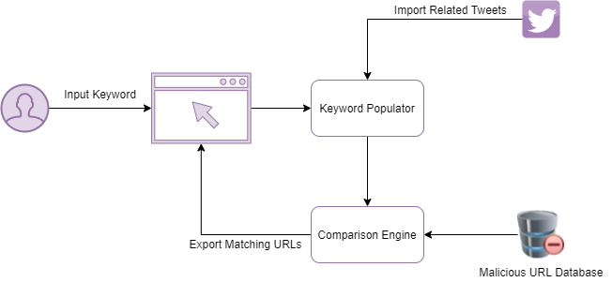
System Diagram
IT18032666 | Wishvajith B.L.D.V. | 2021-085 18.10.2021
Notes:
http://cs229.stanford.edu/proj2012/ChongLiu-MaliciousURLDetection.pdf [2]
https://arxiv.org/pdf/1009.2275v1.pdf [3]
https://escholarship.org/uc/item/4q3611mk#figure.caption.56 [4]

Slide 32
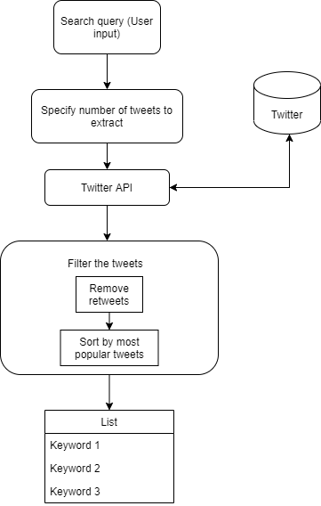
Methodology
Populating Keywords
Keyword Populator
Leverage Twitter API to extract real time tweets.
Derive keywords from the tweets.
IT18032666 | Wishvajith B.L.D.V. | 2021-085 18.10.2021

Slide 33
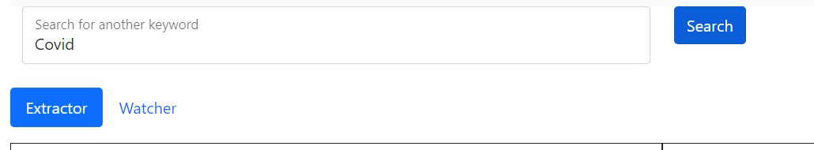
Methodology
Populating Keywords
Keyword Populator
• User inputs a keyword using the web interface. (ex : Covid, Earthquake)
IT18032666 | Wishvajith B.L.D.V. | 2021-085 18.10.2021

Slide 34
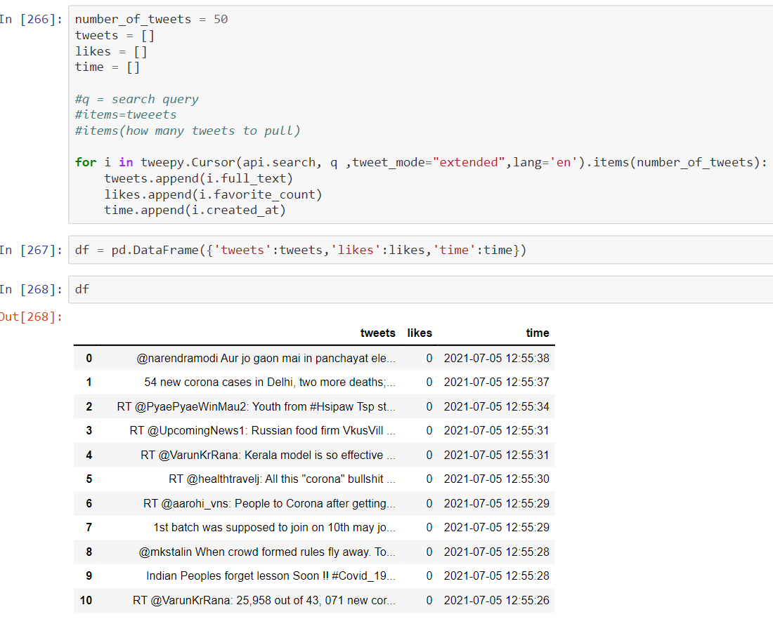
Methodology
Populating Keywords - Keyword Populator
• Keyword populator will use the Twitter API to find related, real-time tweets from Twitter.
• Specify the number of tweets to extract.
• Import the keywords to a data frame.
IT18032666 | Wishvajith B.L.D.V. | 2021-085 18.10.2021

Slide 35
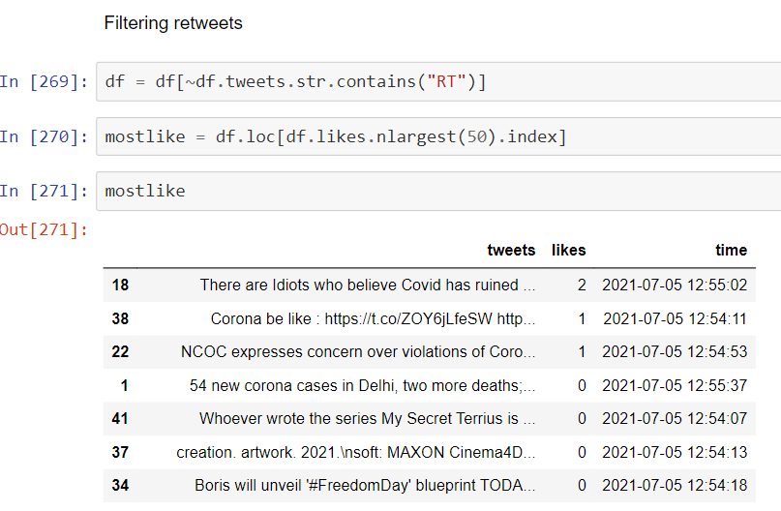
Methodology
• Imported tweets are filtered to remove Re-tweets.
Populating Keywords - Keyword Populator
IT18032666 | Wishvajith B.L.D.V. | 2021-085 18.10.2021

Slide 36
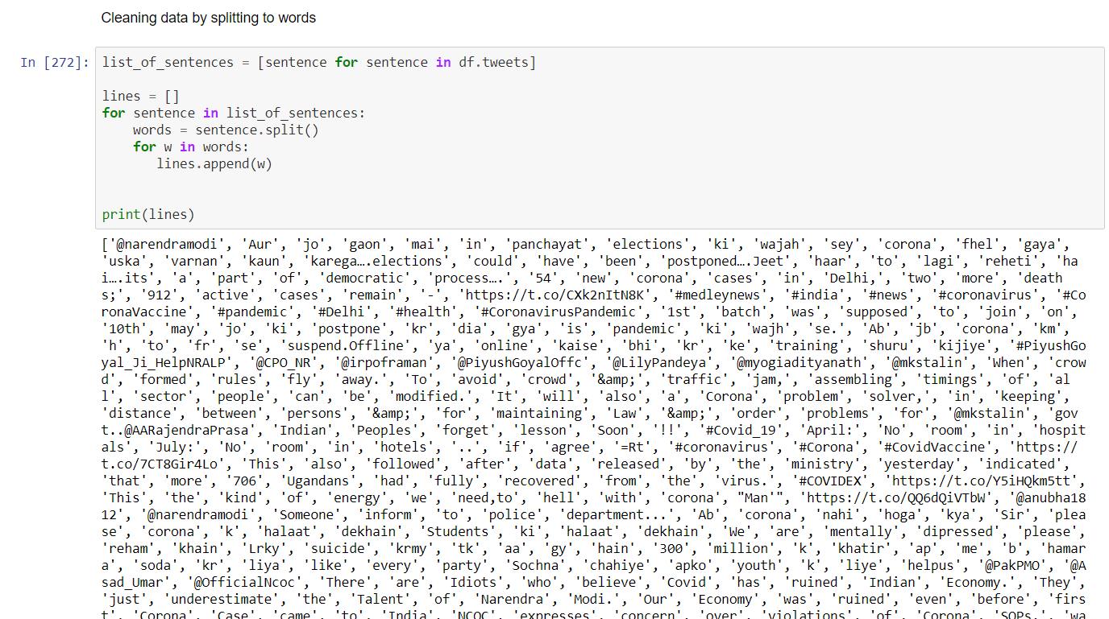
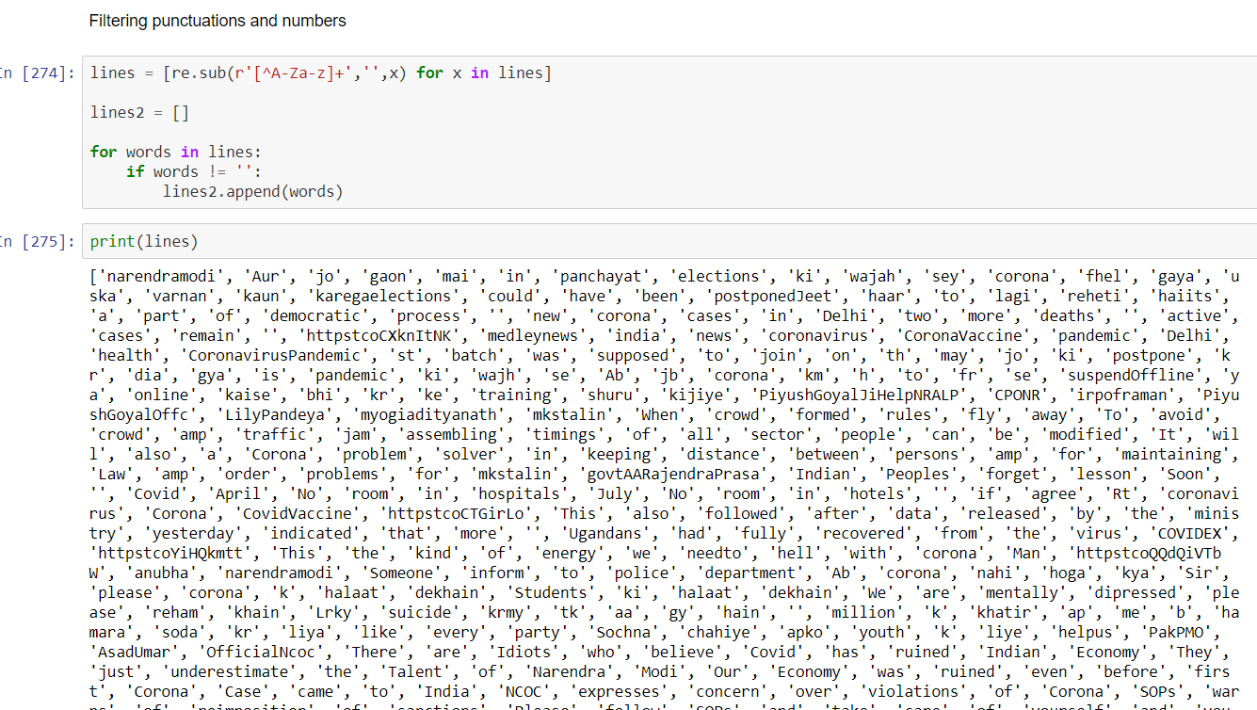
Methodology
Populating Keywords - Keyword Populator
• Tweets are separated into words and appended to a list for cleaning.
IT18032666 | Wishvajith B.L.D.V. | 2021-085 18.10.2021

Slide 37
Methodology
Populating Keywords - Keyword Populator
• Generated keywords will be saved in a .csv file to be used by the comparison model.
IT18032666 | Wishvajith B.L.D.V. | 2021-085 18.10.2021

Slide 38
Methodology
Comparison Engine
Results (Keywords) from the keyword populator will be compared with processed URL tokens to match.
Matching set of URLs containing the event related tokens will be collected from malicious URL database.
User will be given the options to export the generated list to a .csv file
IT18032666 | Wishvajith B.L.D.V. | 2021-085 18.10.2021
Notes:
http://cs229.stanford.edu/proj2012/ChongLiu-MaliciousURLDetection.pdf [2]
https://arxiv.org/pdf/1009.2275v1.pdf [3]
https://escholarship.org/uc/item/4q3611mk#figure.caption.56 [4]

Slide 39
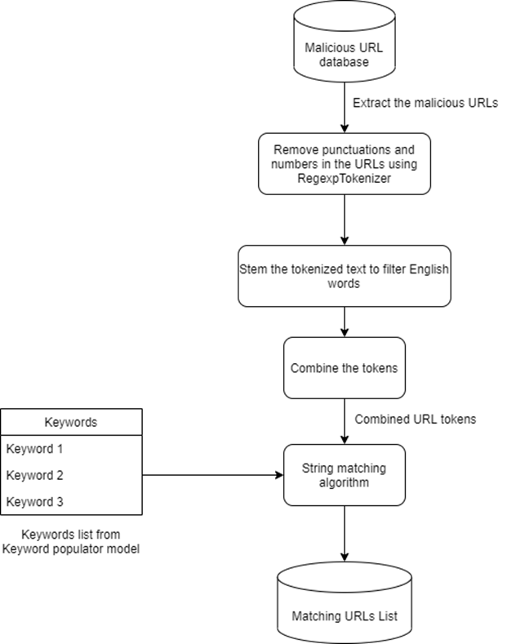
Methodology
Comparison Engine
IT18032666 | Wishvajith B.L.D.V. | 2021-085 18.10.2021
Notes:
http://cs229.stanford.edu/proj2012/ChongLiu-MaliciousURLDetection.pdf [2]
https://arxiv.org/pdf/1009.2275v1.pdf [3]
https://escholarship.org/uc/item/4q3611mk#figure.caption.56 [4]

Slide 40
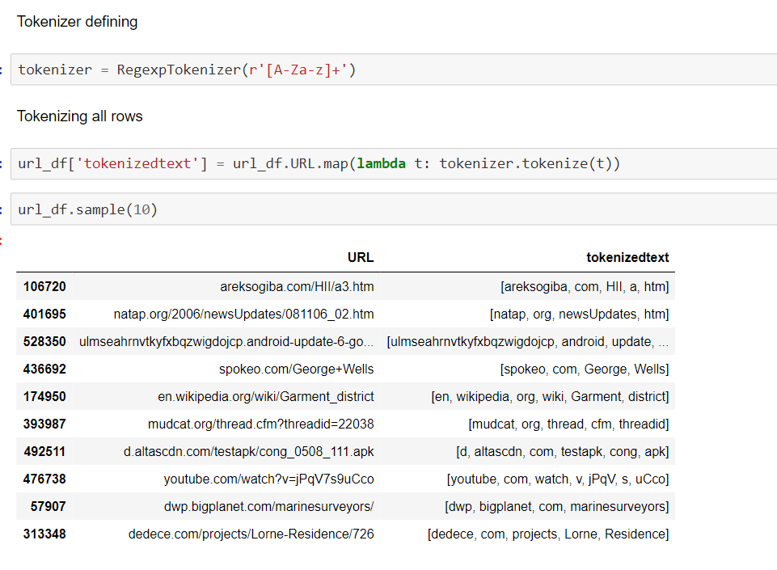
Methodology
Comparison Engine
• Import the malicious URL links from classified URLs in database.
Dataset - phishing-site-urls [4]
• Tokenize the URLs using Regexp Tokenizer.
• Filter digits, emojis and punctuation marks.
IT18032666 | Wishvajith B.L.D.V. | 2021-085 18.10.2021
Notes:
http://cs229.stanford.edu/proj2012/ChongLiu-MaliciousURLDetection.pdf [2]
https://arxiv.org/pdf/1009.2275v1.pdf [3]
https://escholarship.org/uc/item/4q3611mk#figure.caption.56 [4]

Slide 41
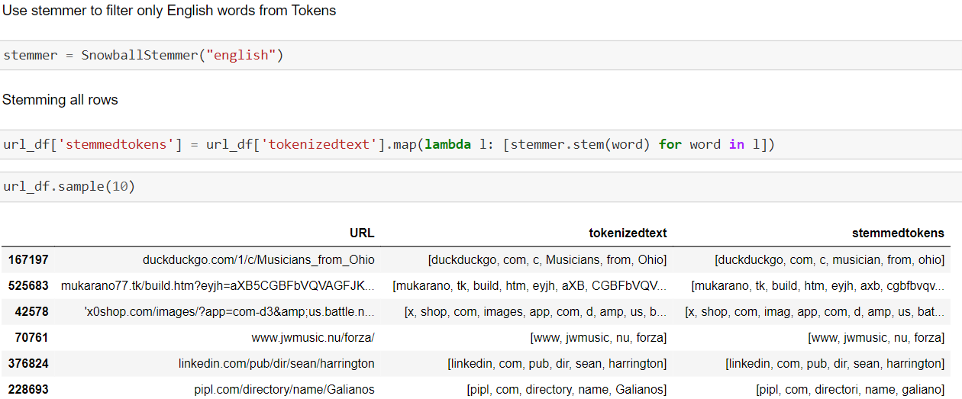
Methodology
Comparison Engine
• Stem the tokenized words/phrases.
• Filter only the tokens containing English words
IT18032666 | Wishvajith B.L.D.V. | 2021-085 18.10.2021
Notes:
http://cs229.stanford.edu/proj2012/ChongLiu-MaliciousURLDetection.pdf [2]
https://arxiv.org/pdf/1009.2275v1.pdf [3]
https://escholarship.org/uc/item/4q3611mk#figure.caption.56 [4]

Slide 42
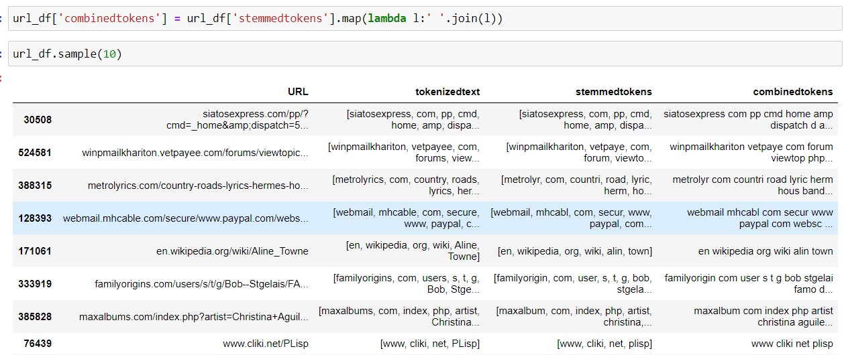
Methodology
Comparison Engine
• Stemmed tokens are combined together.
IT18032666 | Wishvajith B.L.D.V. | 2021-085 18.10.2021
Notes:
http://cs229.stanford.edu/proj2012/ChongLiu-MaliciousURLDetection.pdf [2]
https://arxiv.org/pdf/1009.2275v1.pdf [3]
https://escholarship.org/uc/item/4q3611mk#figure.caption.56 [4]

Slide 43
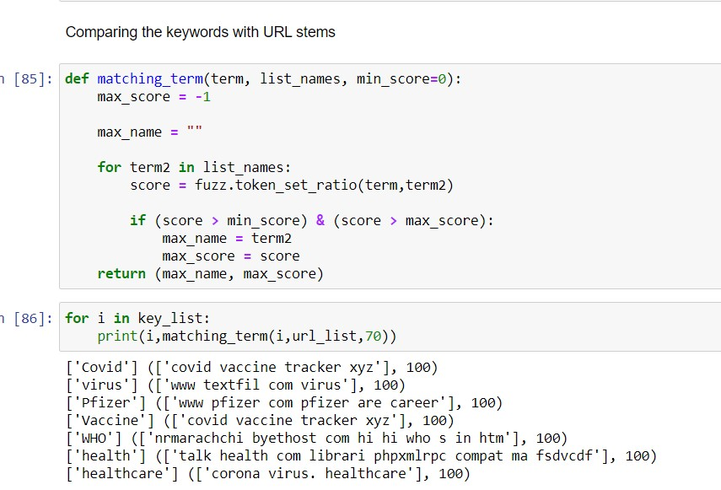
Methodology
Comparison Engine
• Match the tokenized URLs against the keywords from populator module
• Levenshtein distance measuring python library, FuzzyWuzzy will be used.
• Token-set-ratio - score of minimum 70 percent match ratio to compute the matching terms
IT18032666 | Wishvajith B.L.D.V. | 2021-085 18.10.2021
Notes:
http://cs229.stanford.edu/proj2012/ChongLiu-MaliciousURLDetection.pdf [2]
https://arxiv.org/pdf/1009.2275v1.pdf [3]
https://escholarship.org/uc/item/4q3611mk#figure.caption.56 [4]

Slide 44

Methodology
Comparison of similarity scores in comparison engine
100 keywords were matched against 549,346 URLs.
Similarity Score | Time to completion |  | Accuracy of the output URL list | Number of Output URLs
 | 100 keywords | 1 keyword
100 % | 62 mins | 0.62 mins | 98.1% | 3
75 % | 57 mins | 0.57 mins | 66.2 % | 28
50 % | 116 mins | 1.16 mins | 43 % | 52
25 % | 60 mins | 0.6 mins | 19.7 % | 63
IT18032666 | Wishvajith B.L.D.V. | 2021-085 18.10.2021
Notes:
http://cs229.stanford.edu/proj2012/ChongLiu-MaliciousURLDetection.pdf [2]
https://arxiv.org/pdf/1009.2275v1.pdf [3]
https://escholarship.org/uc/item/4q3611mk#figure.caption.56 [4]

Slide 45
Methodology
Comparison Engine
• User will be offered the option to export the matching URLs to a .csv file.
IT18032666 | Wishvajith B.L.D.V. | 2021-085 18.10.2021
Notes:
http://cs229.stanford.edu/proj2012/ChongLiu-MaliciousURLDetection.pdf [2]
https://arxiv.org/pdf/1009.2275v1.pdf [3]
https://escholarship.org/uc/item/4q3611mk#figure.caption.56 [4]

Slide 46





Technologies / Tools and Libraries Used
IT18032666 | Wishvajith B.L.D.V. | 2021-085 18.10.2021

Slide 47
Completion of the Project
IT18032666 | Wishvajith B.L.D.V. | 2021-085 18.10.2021

Slide 48
Keyword Populator
Completed | To do / Improve
Experiment with methods to find a suitable method for finding keywords related to user input | Improve the quality of the keywords
Find URL dataset for testing
Wrote a script to collect tweets related to user input using Twitter API
Generation of keywords from the tweets
Test the model for various inputs
IT18032666 | Wishvajith B.L.D.V. | 2021-085 18.10.2021
Notes:
http://cs229.stanford.edu/proj2012/ChongLiu-MaliciousURLDetection.pdf [2]
https://arxiv.org/pdf/1009.2275v1.pdf [3]
https://escholarship.org/uc/item/4q3611mk#figure.caption.56 [4]

Slide 49
Comparison Engine
Completed | To do / Improve
Find URL dataset for testing | Improve the quality of the keyword tokens
Generating keyword tokens from URLs.
Mapping keywords from populator with keyword tokens
IT18032666 | Wishvajith B.L.D.V. | 2021-085 18.10.2021
Notes:
http://cs229.stanford.edu/proj2012/ChongLiu-MaliciousURLDetection.pdf [2]
https://arxiv.org/pdf/1009.2275v1.pdf [3]
https://escholarship.org/uc/item/4q3611mk#figure.caption.56 [4]

Slide 50
References
[1] | Mohammad Saiful, Islam Mamun, Mohammad Ahmad Rathore, Arash Habibi Lashkari, Natalia Stakhanova, and Ali A. Ghorbani, "Detecting Malicious URLs Using Lexical," in University of New Brunswick, Fredericton, NB, Canada, Fredericton, 2016.
[2] | Vishal A. Kharde, S.S. Sonawane, "Sentiment Analysis of Twitter Data: A Survey of Techniques," International Journal of Computer Applications (0975 – 8887), vol. Volume 139, no. 11, p. 15, 2016.
[3] | Ozgur Koray Sahingoz, Ebubekir Buber, Onder Demir, Banu Diri, "Machine learning based phishing detection from URLs," Expert Systems With Applications, 2019.
[4] | T. Tiwari, "Phishing Site URLs," Kaggle, 2020. [Online]. Available: https://www.kaggle.com/taruntiwarihp/phishing-site-urls.
IT18032666 | Wishvajith B.L.D.V. | 2021-085 18.10.2021
Notes:
http://cs229.stanford.edu/proj2012/ChongLiu-MaliciousURLDetection.pdf [2]
https://arxiv.org/pdf/1009.2275v1.pdf [3]
https://escholarship.org/uc/item/4q3611mk#figure.caption.56 [4]

Slide 51
Ramanayaka A. M IT18021912
IT18021912 | Ramanayaka A. M | 2021-085 18.10.2021

Slide 52
Research Objectives
Ensemble Model
Feature Reduction
01
02
Improve accuracy without decreasing performance
Reduce dimensionality of the extracted features
Event-driven System
Scalability
03
04
To detect attacks early in the life cycle
Scales the system when increase in URLs and keywords.
IT18021912 | Ramanayaka A. M | 2021-085 18.10.2021

Slide 53
Research Objective
How can the feature reduction be done to build an ensemble model that will be efficient enough to detect phishing URLs with better scalability and speed?
IT18021912 | Ramanayaka A. M | 2021-085 18.10.2021

Slide 54
Objectives
IT18021912 | Ramanayaka A. M | 2021-085 18.10.2021

Slide 55
Feature Reduction
Feature Classification
Feature Extraction
Feature Analysis
Feature Reduction
IT18021912 | Ramanayaka A. M | 2021-085 18.10.2021

Slide 56
Methodology
IT18021912 | Ramanayaka A. M | 2021-085 18.10.2021

Slide 57
An Insight to the Process
Feature reduction is done using Random Forest Method
What is Random Forest Method?
Features of Random Forest Method
Feature Classification and Feature Reduction is done with this method.
IT18021912 | Ramanayaka A. M | 2021-085 18.10.2021

Slide 58
An Insight to the Process
Technical Information
Coding Language – Python
Tools – Jupyter Notebook via Anaconda Navigator
Main Libraries – Pandas, Seaborn
Modules - WHOIS
IT18021912 | Ramanayaka A. M | 2021-085 18.10.2021

Slide 59
Feature Classification
IT18021912 | Ramanayaka A. M | 2021-085 18.10.2021

Slide 60
Feature Classification Process
Feature Classification was done by a study done on few researches which showed the best results.
IT18021912 | Ramanayaka A. M | 2021-085 18.10.2021

Slide 61
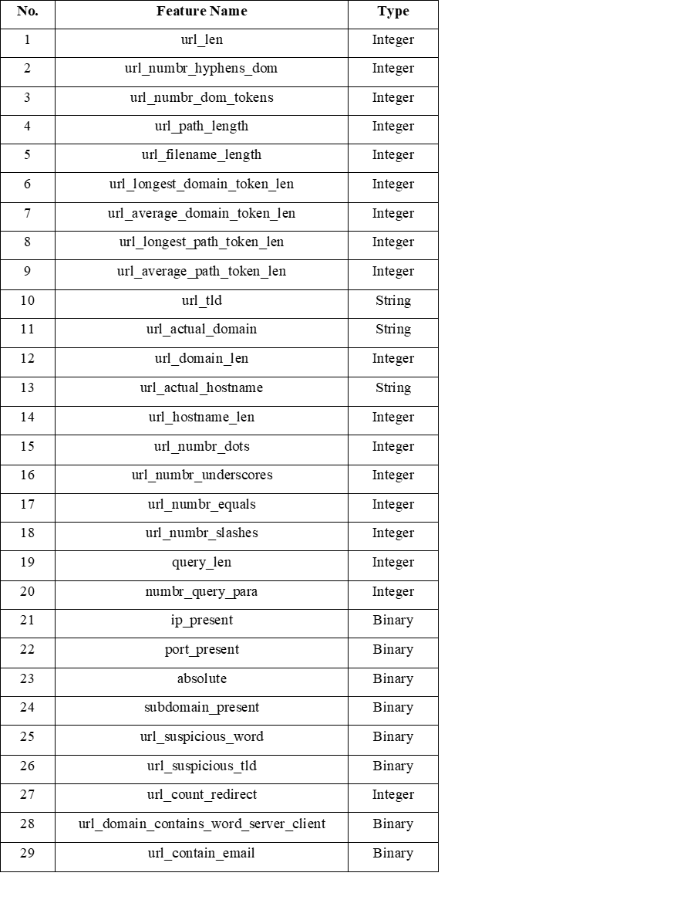
URL Based Features
Study 1
IT18021912 | Ramanayaka A. M | 2021-085 18.10.2021

Slide 62
Host Based Features
Study 1
No. | Feature Name | Type
1 | host_age_create_mon | Integer
2 | host_age_exp_mon | Integer
3 | host_age_update_days | Integer
4 | update_date | Binary
5 | create_date | Binary
6 | expiry_date | Binary
7 | zipcode | Binary
8 | Status | String
9 | org_name | Binary
10 | dnssec | String
11 | city | Binary
12 | state | Binary
13 | country | Binary
14 | whois_server | Binary
15 | referral_url | Binary
IT18021912 | Ramanayaka A. M | 2021-085 18.10.2021

Slide 63
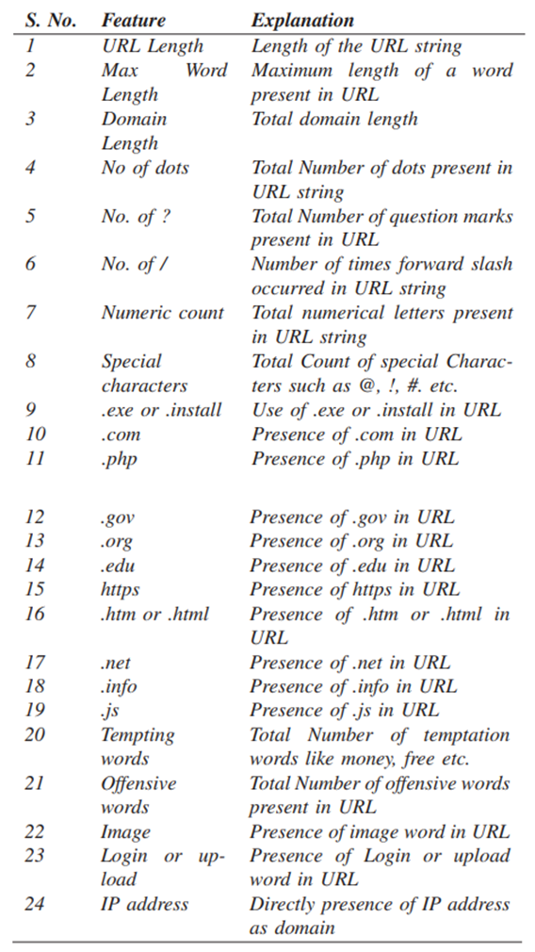
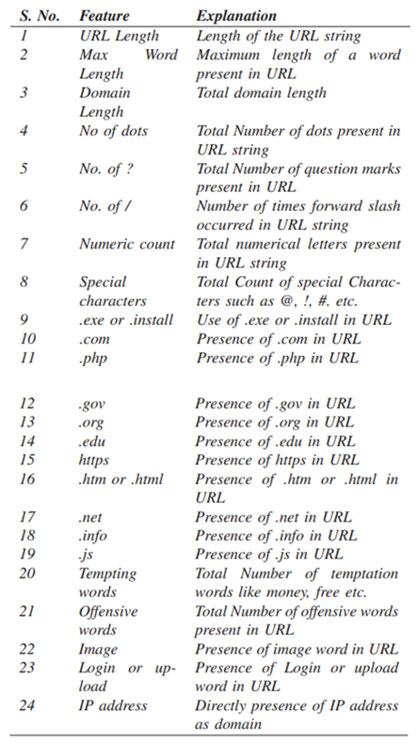
Malicious URL Feature Classification
Study 2
IT18021912 | Ramanayaka A. M | 2021-085 18.10.2021

Slide 64
Final Malicious URL Feature Classification
Address Bar based features | Domain based features | HTML & JavaScript based features
Domain of URL | DNS (Domain Name System) Record | iFrame Redirection
IP (Internet Protocol) Address in URL | Website Traffic | Status Bar Customization
Presence of @ | Age of Domain | Disabling Right Click
Length of URL | End Period of Domain | Website Forwarding
Depth of URL
Redirection // in URL
http/https in Domain name
Use of URL shortening services
Prefix/Suffix “- “in Domain
IT18021912 | Ramanayaka A. M | 2021-085 18.10.2021

Slide 65
Feature Extraction
IT18021912 | Ramanayaka A. M | 2021-085 18.10.2021

Slide 66
Process
Loading data sets
Phishing URL data set from PhishTank
http://data.phishtank.com/data/online-valid.csv
Dataset containing Legitimate URLs and other Malicious URLs downloaded from UNB
https://www.unb.ca/cic/datasets/url-2016.html
Datasets will be downloaded and the URLs in them will be checked for the previously mentioned features and then will be extracted
IT18021912 | Ramanayaka A. M | 2021-085 18.10.2021

Slide 67
Process -Continued..
URLs would be randomly chosen from both data sets.
Feature extraction would be done on them
If malicious – return value 1, if legitimate – return value 0
The list would be converted to a dataframe
Two lists created after feature extraction: one with legitimate and malicious URLs, and other with phishing URLs.
They will then be concatenated and exported as a separate .csv file for feature analysis.
IT18021912 | Ramanayaka A. M | 2021-085 18.10.2021

Slide 68
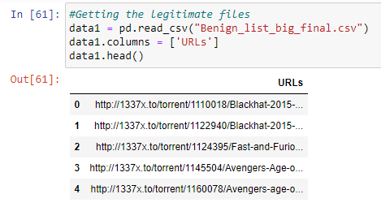
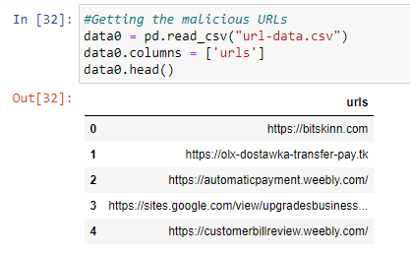
IT18021912 | Ramanayaka A. M | 2021-085 18.10.2021

Slide 69
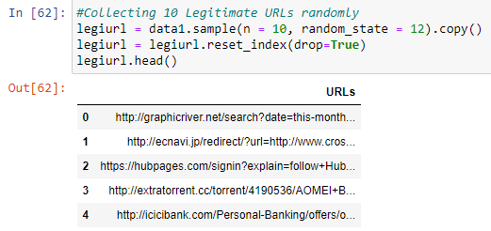
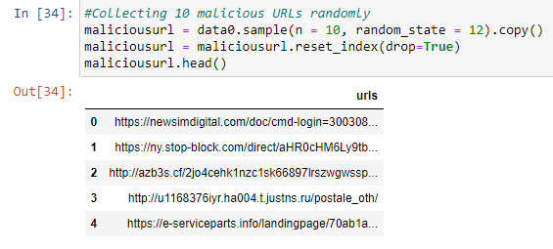
IT18021912 | Ramanayaka A. M | 2021-085 18.10.2021

Slide 70
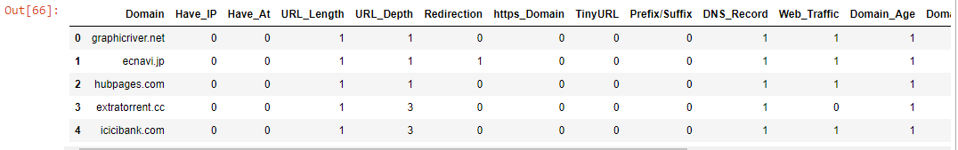
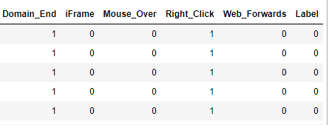
Storing features of legitimate + malicious URLs in a data frame
IT18021912 | Ramanayaka A. M | 2021-085 18.10.2021

Slide 71
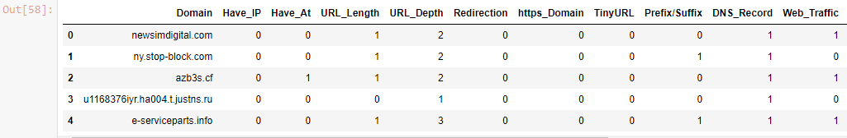
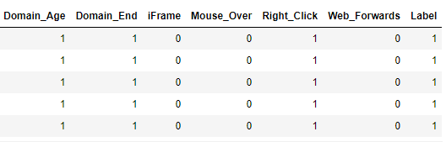
Storing features of phishing URLs in a data frame
IT18021912 | Ramanayaka A. M | 2021-085 18.10.2021

Slide 72
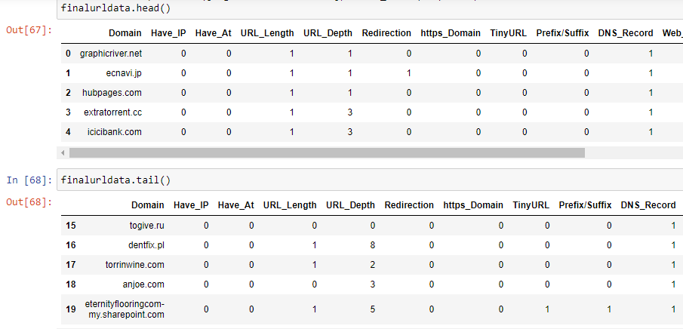
Concatenated data that was stored in a .csv file
IT18021912 | Ramanayaka A. M | 2021-085 18.10.2021

Slide 73
Feature Analysis
IT18021912 | Ramanayaka A. M | 2021-085 18.10.2021

Slide 74
Feature Analysis Process
The previous dataset which was created in feature extraction will be used for this process.
It will be loaded in to a data-frame.
It will be checked for NaN values and rows will be removed.
Then we will get a total of how features were listed for the URL to see which features are the most common
IT18021912 | Ramanayaka A. M | 2021-085 18.10.2021

Slide 75
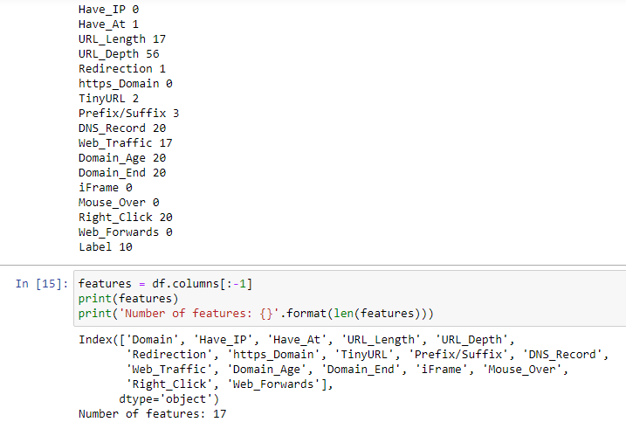
IT18021912 | Ramanayaka A. M | 2021-085 18.10.2021

Slide 76
Feature Reduction
IT18021912 | Ramanayaka A. M | 2021-085 18.10.2021

Slide 77
Feature Reduction Process
The feature analysis is done and we obtained results
It will be checked for the most common and least common features.
The top most common features are kept.
The features with the least effect will be removed.
IT18021912 | Ramanayaka A. M | 2021-085 18.10.2021

Slide 78
Completion Improvements
The feature analysis will be improved – use of seaborn library
IT18021912 | Ramanayaka A. M | 2021-085 18.10.2021

Slide 79
Thank You
IT18021912 | Ramanayaka A. M | 2021-085 18.10.2021

Slide 80
Renu Harshatha A. IT18034400
IT18034400 | Renu Harshatha A. | 2021-085 10.03.2021

Slide 81
Introduction
IT18034400 | Renu Harshatha A. | 2021-085 10.03.2021

Slide 82
Background
From January to April 2020, some 907,000 spam messages, 737 incidents related to malware and 48,000 malicious URLs - all related to Covid-19 were detected [5]
A campaign targeting businesses could see cybercriminals sending out documents that are made to look like government advice on dealing with Brexit which in fact download malware.[7]
As of April 2020, roughly 60,000 include COVID-19 related malicious attachments or malicious URLs. [6]
IT18034400 | Renu Harshatha A. | 2021-085 10.03.2021
Notes:
https://www.rte.ie/news/newslens/2020/0804/1157249-cybercrime/ [5]
https://www.microsoft.com/security/blog/2020/04/08/microsoft-shares-new-threat-intelligence-security-guidance-during-global-crisis/ [6]
https://www.itpro.co.uk/security/32560/spike-in-brexit-themed-phishing-attacks-expected-once-withdrawal-agreement-is [7]

Slide 83

Background
Although there are systems to detect the malicious URLs, most of the researches’ primary focus is accuracy.
Increase in cyber-attacks
IT18034400 | Renu Harshatha A. | 2021-085 10.03.2021

Slide 84
Research Questions
What are the security issues that our system could face?
How are we going tackle the security concerns
How can the proposed solution abide to existing cyber laws around the globe
IT18034400 | Renu Harshatha A. | 2021-085 10.03.2021

Slide 85
Specific and Sub Objectives
Main Objective
Do a study survey on security issues our proposed solution could face.
Suggest how can we overcome this concern
Sub Objectives
Design Extension
Autoscaling the proposed model
IT18034400 | Renu Harshatha A. | 2021-085 10.03.2021

Slide 86

Technologies/ Techniques
IT18034400 | Renu Harshatha A. | 2021-085 10.03.2021

Slide 87
System, Personnel & Software Requirements
Functional Requirements
The system shall collect URL data and warn the user when detect as malicious
Non Functional Requirements
Scalability
Accuracy & Efficiency

Slide 88
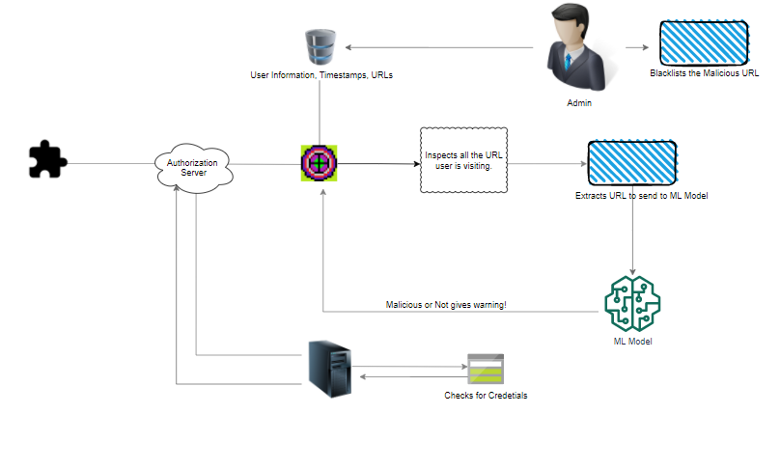
IT18034400 | Renu Harshatha A. | 2021-085 07.07..2021

Slide 89
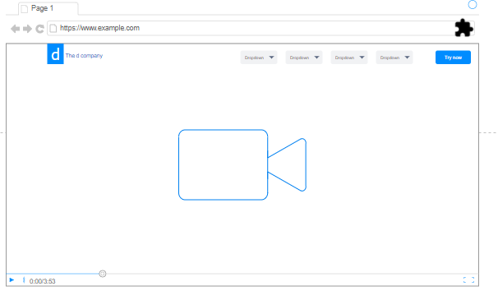
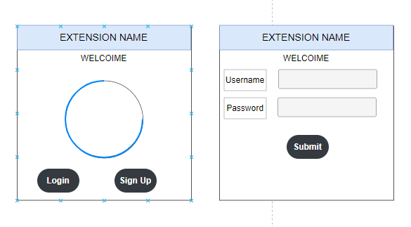
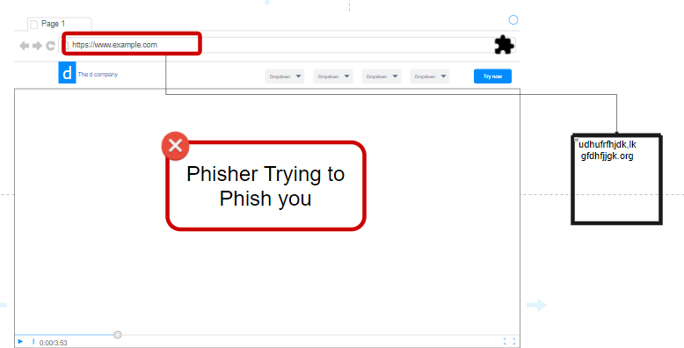
IT18034400 | Renu Harshatha A. | 2021-085 07.07..2021

Slide 90

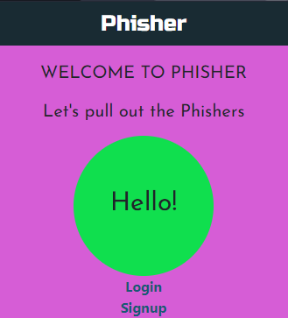
Extension
Secure The Need
IT18034400 | Renu Harshatha A. | 2021-085 07.07..2021

Slide 91
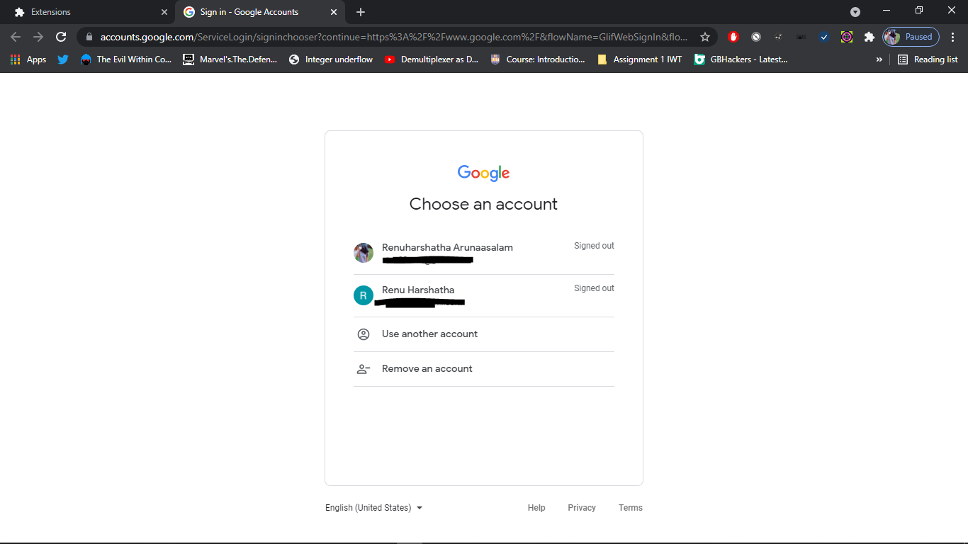
Extension
IT18034400 | Renu Harshatha A. | 2021-085 07.07..2021

Slide 92
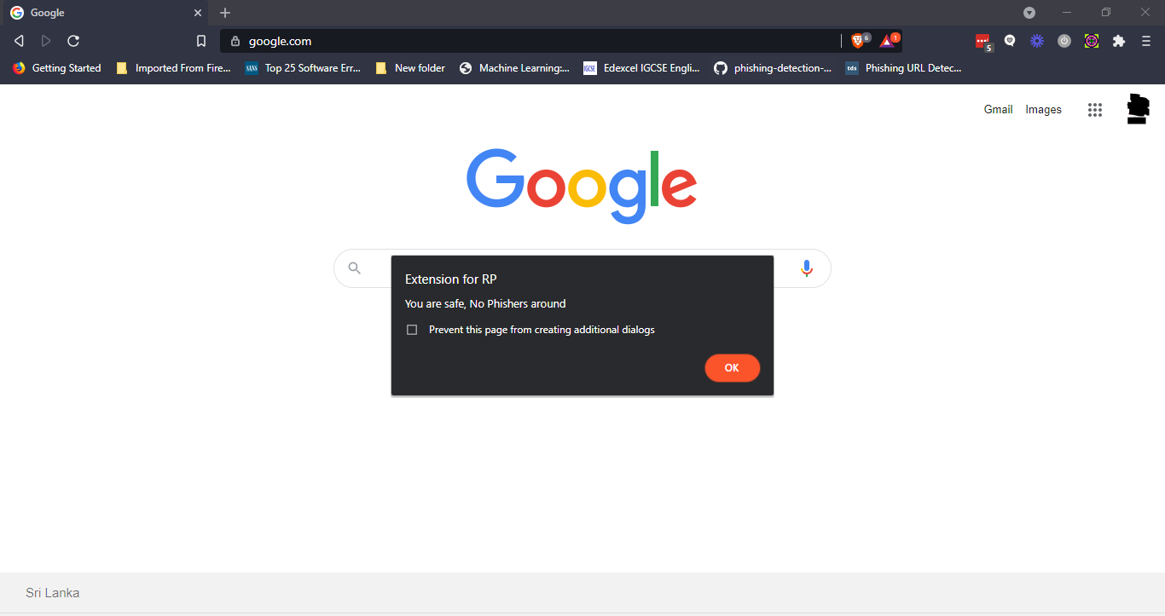
Extension
IT18034400 | Renu Harshatha A. | 2021-085 07.07..2021

Slide 93
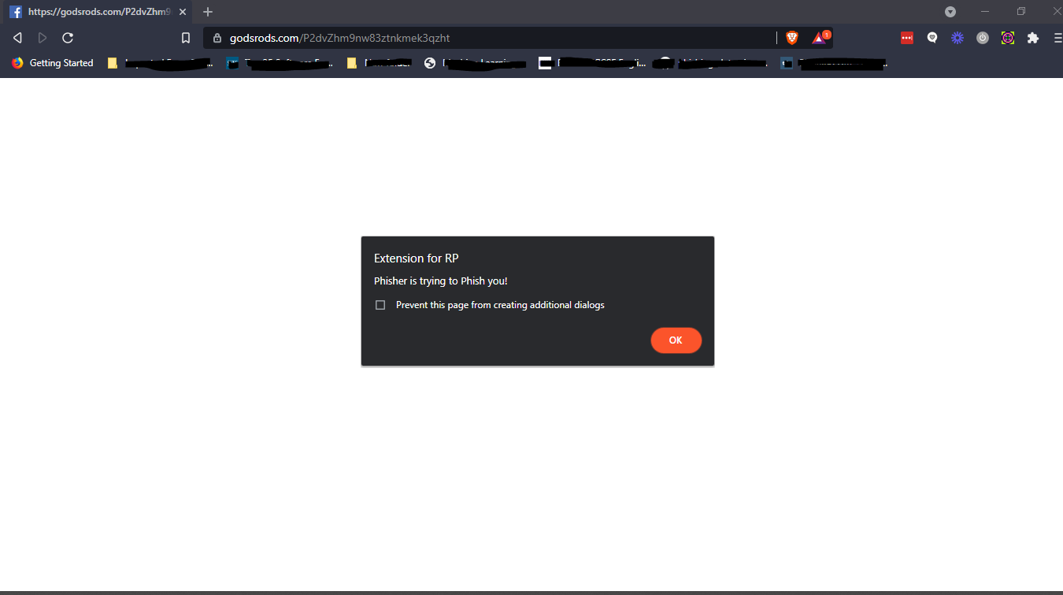
Extension
IT18034400 | Renu Harshatha A. | 2021-085 07.07..2021

Slide 94
Overview
Over past few years ML has been a success, used in many industry.
The success is contributed by following factors
- Availability of Data
- Computational Power
- Deep-Learning Models
Although we celebrate the success of ML, we do have few obstacles which doesn't allow us to get all the benefits of ML.
IT18034400 | Renu Harshatha A. | 2021-085 18.10.2021

Slide 95
Concerns on ML
1. Security concern on data privacy and confidentiality, cyber legislation that monitors and governs.
2. Challenges faced in building a ML model due to training and implementation of the computational cost
IT18034400 | Renu Harshatha A. | 2021-085 18.10.2021
Notes:
There are multiple cloudbased companies booming and providing well-trained ML models, which address our 2nd concern, however our 1st concern is left unaddressed.

Slide 96
Security concerns
1. Data breaches
2. Privacy concerns
3. Security threats
4. Abiding to cyber legislation
IT18034400 | Renu Harshatha A. | 2021-085 18.10.2021
Notes:
Distributed Machine Learning, allows clients to store their data locally but train the model collaboratively. This provides higher accuracy and better perfomance but the security is weaker.
We can incorporated machine learning with privacy protection technologies like secure Multiparty computation MPC, Homomorphic Encryption, and differential privacy, this is a good approach but again this provides good security posture as this focuses on security on the other hand the accuracy and perfomance of the model remains to be improved.
This creates the gap and leaves our concerns unaddressed.

Slide 97
Distributed Machine Learning
DML – DIstributed Machine Learning solutions proposed to solve challenges of Big Data and computational power while training the ML Model
Due to laws and regulations the distributed data and computing resources can't be directly shared among regions, or organisation for ML purposes/tasks.
IT18034400 | Renu Harshatha A. | 2021-085 18.10.2021
Notes:
Distributed Machine Learning, allows clients to store their data locally but train the model collaboratively. This provides higher accuracy and better perfomance but the security is weaker.
In recent years data and computing resources are distribuuted in the devices of end users, regions, organisation. Due to t

Slide 98
Federated Learning
To address our first concern, about user privacy and confidentiality a ML-based framework has been born named as Federated Learning.
IT18034400 | Renu Harshatha A. | 2021-085 18.10.2021
Notes:
FL address these concerns by providing a highly trained ML model without exposing training data.
It also solves the issue of having inadequate data, how is that solved? Because FL is providing a trust factor among hetero domains
By default FL is an eeficient approach which obeys the laws and regulations by ensuring data security and data privacy
GDPR, PDP, CCPA

Slide 99
What is Federated Learning doing?
Privacy
Preserving user privacy. This technique grabs the attention of different communities.
IT18034400 | Renu Harshatha A. | 2021-085 18.10.2021
Notes:
FL is considered as an iterative process, the central model is improved in each iteration

Slide 100
3 step in Federated Learning
1. Model selection
2. Local Model Training
3. Aggregation of local models
IT18034400 | Renu Harshatha A. | 2021-085 18.10.2021
Notes:
1. Model selection: In this step, the central pre-trained ML model (i.e., global model) and its initial parameters are initiated and then the global ML model is shared with all the clients in the FL environment.
2. Local model training: After sharing the initial ML model and parameters with all clients, the initial ML model at the client level (called local ML models) is trained with individuals training data.
3. Aggregation of local models: Local models are trained at the client level and updates are sent to the central server in order to aggregate and train the global ML model. The global model is updated and the improved model is shared among the individual clients for the next iteration.
Like mentioned before FL is a continuous iterative learning process, so it keep on repating step 2 and 3 so that the global ML model is updated across all the clients

Slide 101
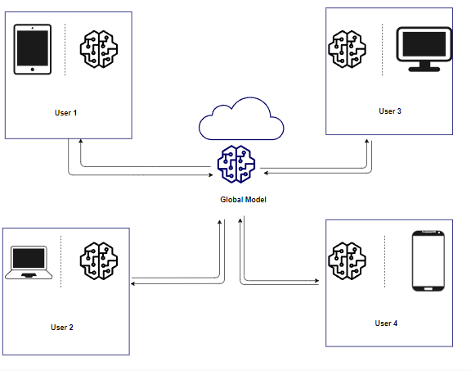
Federated Learning Diagram
IT18034400 | Renu Harshatha A. | 2021-085 18.10.2021
Notes:
FL is a distributed machine learning approach where multiple users collaboratively train a model, while keeping the raw data decentralized without being moved to a single server or data center
. FL only allows the intermediate data to be transferred among the distributed computing resources while avoiding the transfer of training data
FL brings the code to the data, instead of bringing the data to the code, and it addresses the fundamental problems of privacy, ownership, and locality of data
This way FL can enable multiple users to train a model while satisfying the legal data restrictions
FL differs from the centralized approach in three aspects. First, FL does not allow direct raw data communication, while the centralized approach has no restriction. Second, FL exploits the distributed computing resources in multiple regions or organizations, while the centralized approach generally only utilizes a single server or a cluster in a single region, which belongs to a single organization. Third, FL generally takes advantage of encryption or other defense techniques to ensure the data privacy or security, while the centralized approach pays little attention to this security issue

Slide 102
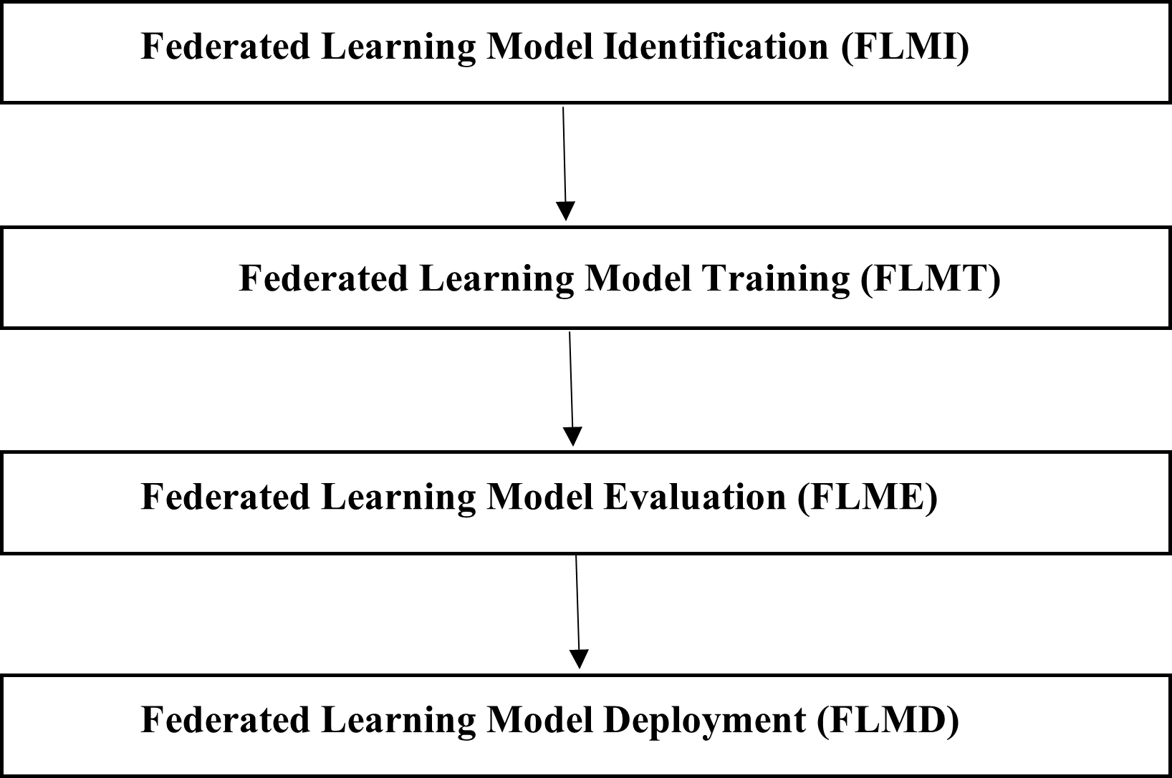
Federated Learning Life Cycle (FLLC)
IT18034400 | Renu Harshatha A. | 2021-085 18.10.2021
Notes:
The life cycle of an FL model is a description of the state transitions of an FL model from creation to completion Researcher Lo propose that the life cycle of an FL model consists of 9 phases, i.e., initiated, broadcast, trained, transmitted, aggregated, evaluated, deployed, and monitored. Researcher Kairouz propose that the life cycle of an FL model includes 6 phases, i.e., problem identification, client instrumentation, simulation prototyping, federated model training, model evaluation, deployment.
Federated machine learning: Concept and applications, Joint edge association and resource allocation for cost-efficient hierarchical federated edge learning, A survey of data-intensive scientific workflow management and Advances and open problems in federated learning talks about few variation and application of FL in which these 4 phases were extracted.
Phase 1 : creation of an FL model, which is used to address a specific machine learning problem, e.g., classification. First, a machine learning model is created to address the problem with certain requirements, e.g., the requirement of accuracy. Then, the machine learning model is adapted to FL scenarios.
Phase 2: this is training phase of the FL model. During this phase, a training strategy, which includes parallelism and aggregation algorithms in order to improve the accuracy and the generalization capacity of the FL model.
Phase 3: is to apply the trained FL models, to analyze the performance of the trained FL models. As a result, the FL models with the best performance are selected. If the FL models do not meet the requirements, the FL model should be modified, or the training phase should be carried out again.
Phase 4: deploy the FL model in a real-life scenario to process the data.

Slide 103
Federated Learning Data Distribution
1. Horizontal
2. Vertical
3. Hybrid
IT18034400 | Renu Harshatha A. | 2021-085 18.10.2021
Notes:
The horizontal FL addresses the decentralized data of the same features, while the identifications are different. It also exploits data parallelism which trains multiple instance of same model on different subset of training data
The vertical FL handles the decentralized data of the same identifications with different features. Utilizes model parallelism to distribute paths of single model to multiple devices to handle data of different features
The hybrid FL deals with the data of different identifications and different features
FL is formally defined as a machine learning approach where multiple clients collaborate in solving a machine learning problem while the raw data is stored locally and is neither exchanged nor transferred

Slide 104
Securing the Model
Techniques to protect data privacy consist of 3 types
1. Trusted Execution Environment
2.Differential Privacy and encryption
3. Cryptographic methods
IT18034400 | Renu Harshatha A. | 2021-085 18.10.2021
Notes:
These techniques can be combined in FL systems, e.g., the combination of DP and TEE in the combination of encryption and DP and the combination of DP and anti-GAN
A TEE is an environment where the execution is secured and no information can be leaked to unauthorized users.
TEE has been exploited in FL systems in order to protect the privacy of data in two ways.
1. put the entire training process in the TEE of each distributed computing resource to protect the data privacy during the distributed training
2. TEE to check a small part of the distributed training while exploiting insecure computing resources
Differential Privacy (DP) protects the data privacy by adding artificial noise to a small part of raw data while ensuring that the modification does not substantially affect the performance of the machine learning models
A well-trained machine learning model can leak information about the training data based on the intermediate data
Cryptographic methods such as homomorphic encryption and secure multi-party computation are widely used in privacy-preserving machine learning algorithms. Basically, the parties have to encrypt their messages before sending, operate on the encrypted messages, and decrypt the encrypted output to get the result. Applying the above methods, the user privacy of federated learning systems can usually be well protected

Slide 105

Progress in PP1
60%
IT18034400 | Renu Harshatha A. | 2021-085 18.10.2021

Slide 106

Progress in PP2
90%
IT18034400 | Renu Harshatha A. | 2021-085 18.10.2021

Slide 107
References
[1] nomad. (2021, February 28). Nomad Vs. Kubernetes. Retrieved from nomadproject.io: https://www.nomadproject.io/docs/nomad-vs-kubernetes
[2] I. M. M. A. R. A. H. L. N. S. a. A. A. G. Mohammad Saiful, "Detecting Malicious URLs Using Lexical," in University of New Brunswick, Fredericton, NB, Canada, Fredericton, 2016.
[3] S. S. Vishal A. Kharde, "Sentiment Analysis of Twitter Data: A Survey of Techniques," International Journal of Computer Applications (0975 – 8887), vol. Volume 139, no. 11, p. 15, 2016.
[4] E. B. O. D. B. D. Ozgur Koray Sahingoz, "Machine learning based phishing detection from URLs," Expert Systems With Applications, 2019.
[5] RTE. (2020, August Tuesday). 'Alarming' cybercrime increase during Covid-19 pandemic, says Interpol. Retrieved from RTE: https://www.rte.ie/news/newslens/2020/0804/1157249-cybercrime/
[6] Rob Lefferts. (2020, April 8). Microsoft shares new threat intelligence, security guidance during global crisis. Retrieved from Microsoft : https://www.microsoft.com/security/blog/2020/04/08/microsoft-shares-new-threat-intelligence-security-guidance-during-global-crisis/
[7] expected once withdrawal agreement is finalised: https://www.itpro.co.uk/security/32560/spike-in-brexit-themed-phishing-attacks-expected-once-withdrawal-agreement-is
IT18034400 | Renu Harshatha A. | 2021-085 18.10.2021

Slide 108
Supportive Information

Slide 109
Budget Plan
Task | Cost ($) | Cost (Rs.)
Azure Machine Learning Service | 60 (Annual Fee) | 12000.00
Azure Web Deployement | 144 (Annual Fee) | 28800.00
MongoDB | 57 | 11400.00
Total |  | 52200
18.10.2021

Slide 110
Commercialization
Income from Web Application
- Subscription model
Target Audience
General Public
Buisnesses
- Freelancers
- Privacy-minded users
- Students/ Children
- Small to Medium Enterprises
- Startups
-
IT18034400 | Renu Harshatha A. | 2021-085 18.10.2021

Slide 111

Pricing Model
Free-trial
Chrome Extension available upto 5 users.
Premium Users
Reporting Dashboard
Administrative controls for the Extension
Pricing Tier wil depend on number of extension purchased
IT18034400 | Renu Harshatha A. | 2021-085 18.10.2021

Slide 112
Thanks!

